Slide 1
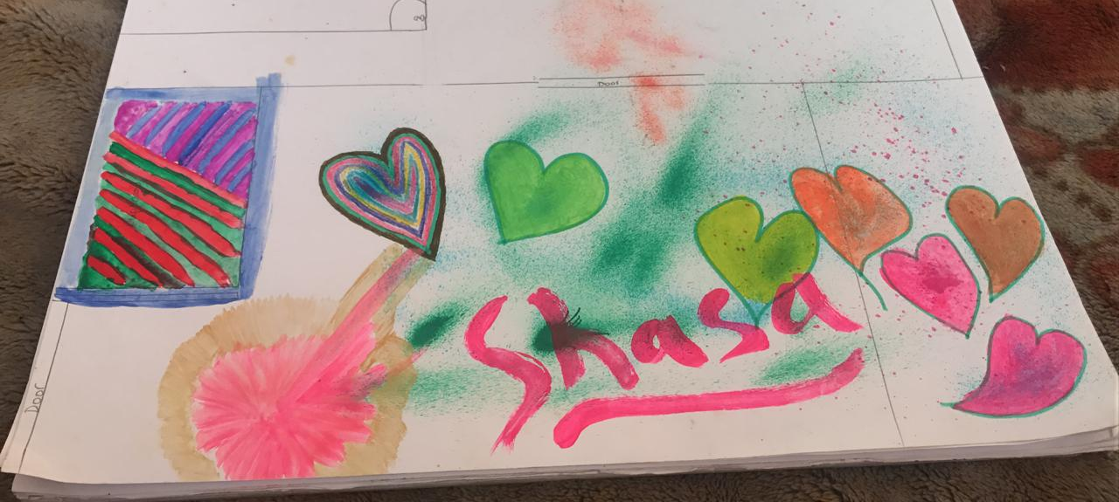
Universal Life Church Monastery, Egmore Annexe welcomes you

Slide 2
First Rule
No Booze, Nicotine or Tobacco.
Only Positivity with Generosity, Humility and Purity.
Yama Niyama

Slide 3
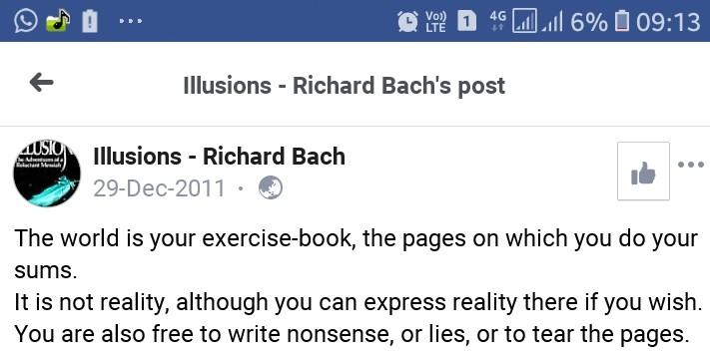
NO CAMERAS, do what you please. Ours is a TRUTH STORE

Slide 4
SERVE each other with learning healing and helping
SWOT Analysis and Wishlist Definition and
FULFILMENT

Slide 5
Rejuvenate with visual and lyrical / audio profundity
Try our Persona Inducing Jukebox
Long Road out of EDEN

Slide 6
You reach infinity through 0
Saify will tell you his 5 zeroes concept in time... here's my working list Zero Inventory, Zero Balance, Zero Profit, Zero Waste, Zero Transmission Loss, Zero Latency, Zero Tension, Zero Bitterness, Zero Tolerance Zero Bullshit

Slide 7
ENTHEOS, Enthuse about God and Nature and YOUR life’s philosophy
Evolution is not finished; reason is not the last word nor the reasoning animal the supreme figure of Nature. As man emerged out of the animal, so out of man the superman emerges.

Slide 8
India is my country? NO
Good things about other countries
He didn’t mean in the narrow sense that everyone is or should be like the people living inside the borders of a single country. Nope, for Whitman, “America” was an ideal that anyone could strive for, an ideal of independence, equality, optimism, and brotherly love.

Slide 9
Software Academy
and Media Institute
Logic
Separation of Concerns
Antipatterns
SPECIFICS

Slide 10
SPACE Program, PUSH CAS, One Riot One Ranger
Asymmetric warfare, Lean On ME, Avenging Angels, Disruptive Economics, Dismantling the war machine

